Slide 1
DAFT2021:FINAL PROJECT
NLP ANALYSIS:
VIDEO GAME REVIEWS
IshmaelH

Slide 2


VIDEOGAMES ARE A MULTIBILLION DOLLAR INDUSTRY
With a market value of over $300 Billion USD,
and millions of dollars in cash prizes available at e-sports competitions, it is easy to see the field is exploding.

Slide 3


TO FIND OUT MORE I DECIDED TO LOOK AT VIDEOGAME REVIEWS.

Slide 4

Aggregators like Metacritic provide simple easy to understand numerical scores.

Slide 5
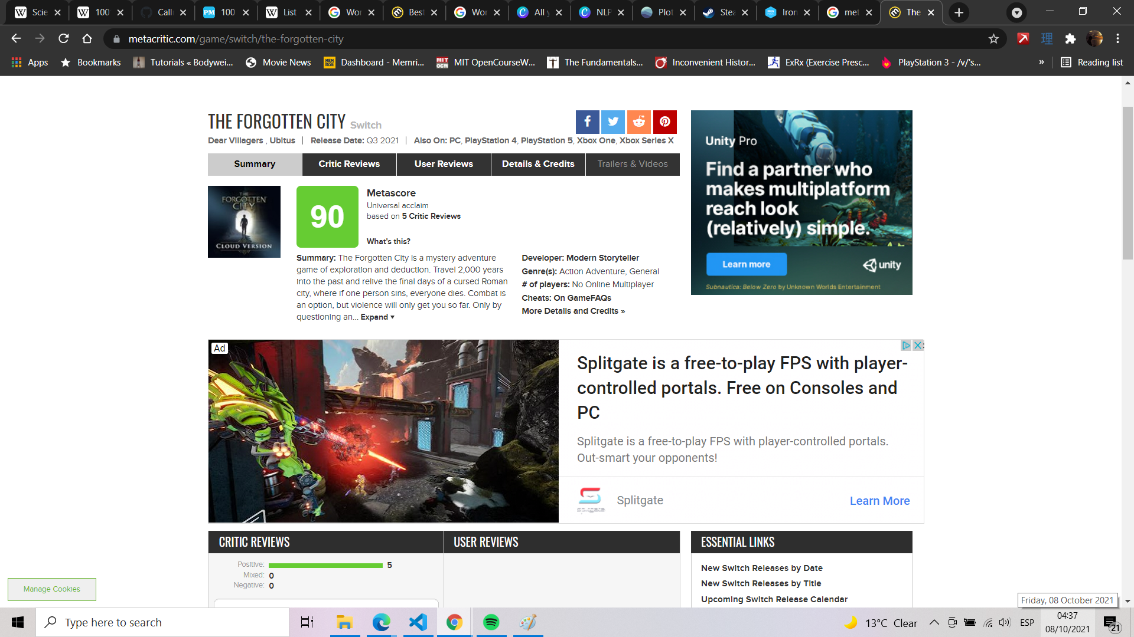
A nice shiney number ... but what does it mean?

Slide 6
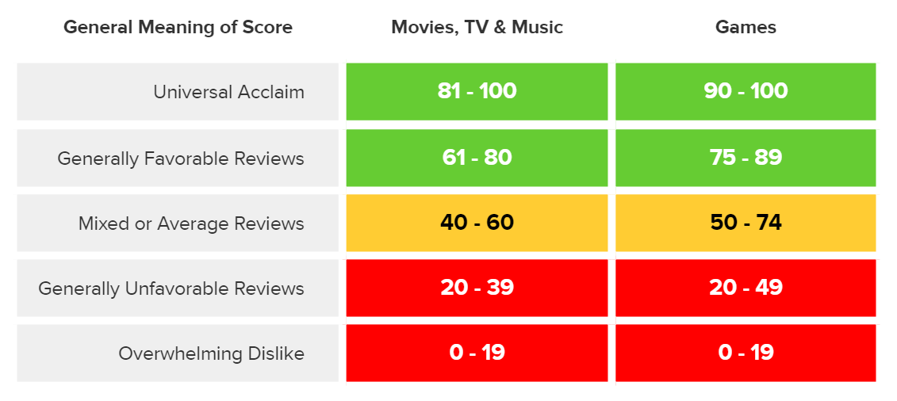

Slide 7
From a business standpoint...
Very easy | Very Vague

Slide 8

Reviews are a great source of insights...

Slide 9


Slide 10
THE RAWG DATA
· 200,000 game titles
|
· not all have metacritic scores
|
·there are a few active reviewers
|
The reviewers are generally ordinary gamers. Not professional critics.

Slide 11

BUT WHAT MAKES A GAME SUCCESSFUL?
"A game should be !" you might say...
FUN
but that only captures a small part of it

Slide 12
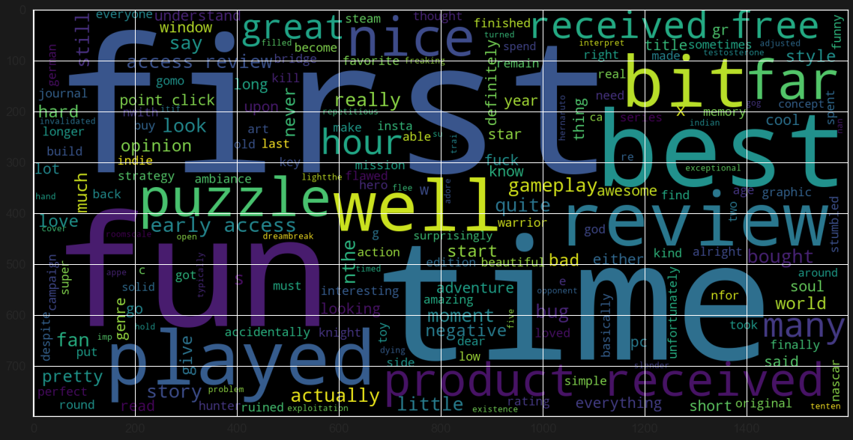

Slide 13
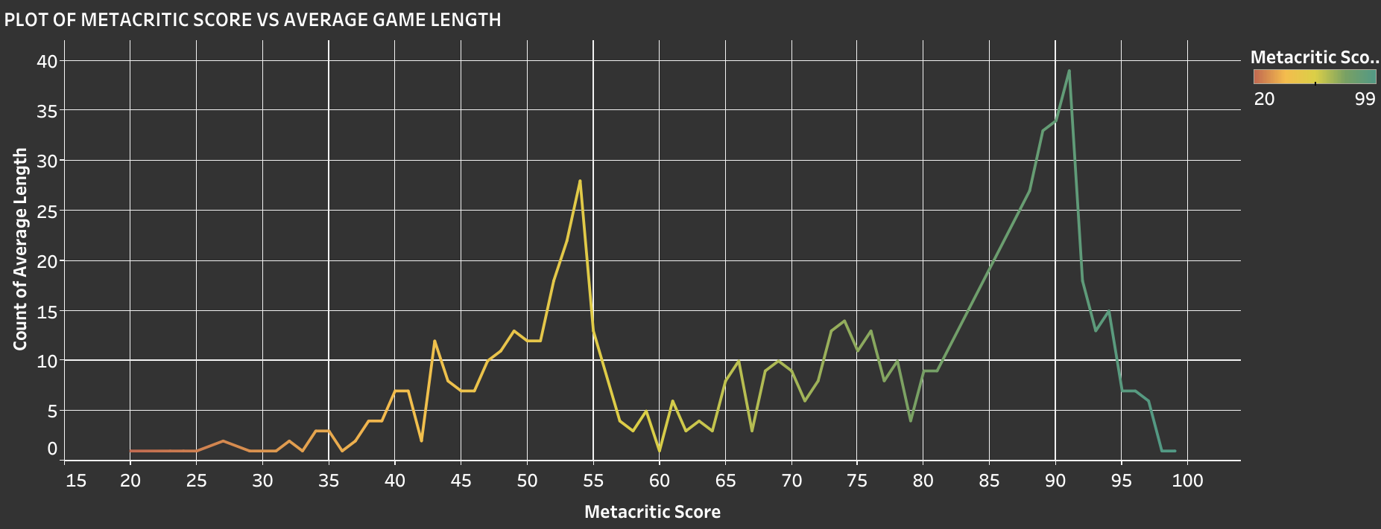
Length of a game:

Slide 14
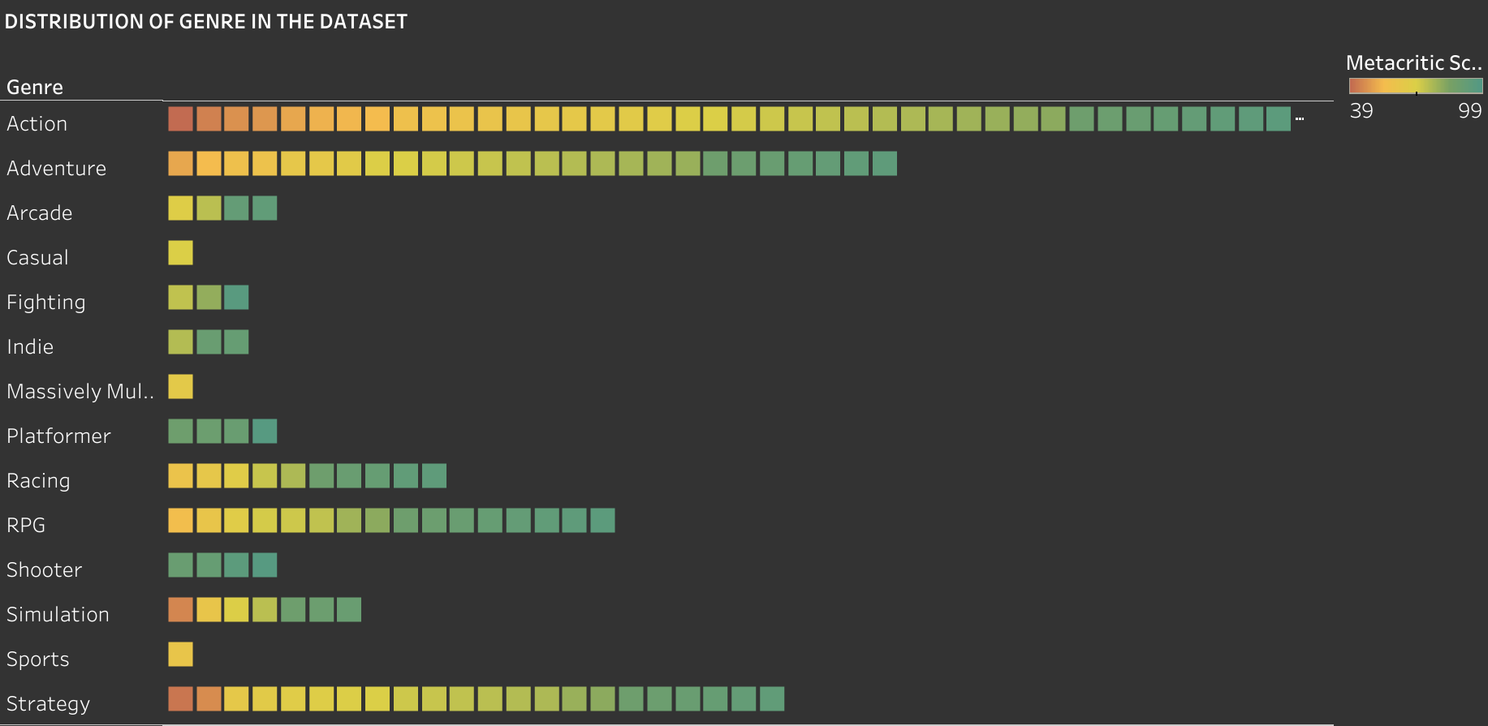
Genre of games:

Slide 15
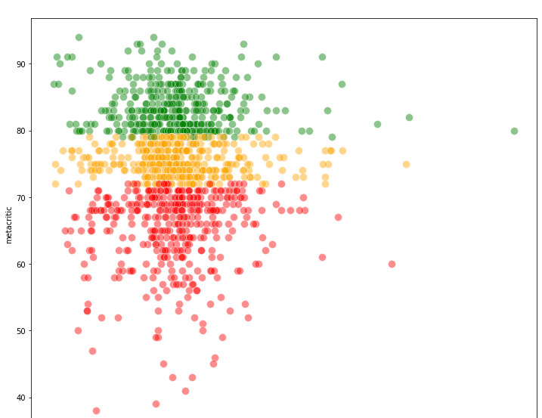
Difference between expectations and outcomes

Slide 16
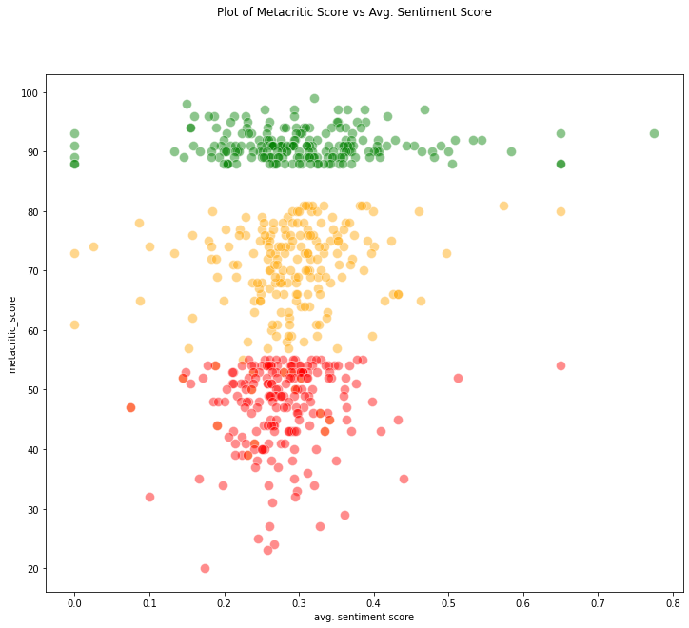

Slide 17
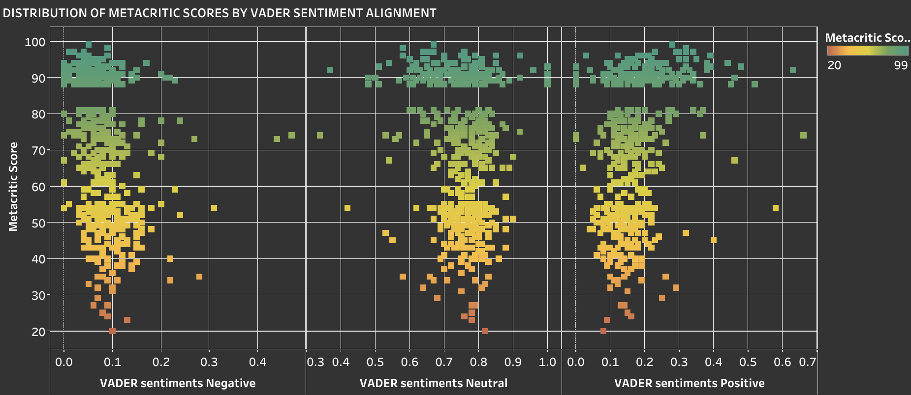
So I consulted VADER

Slide 19
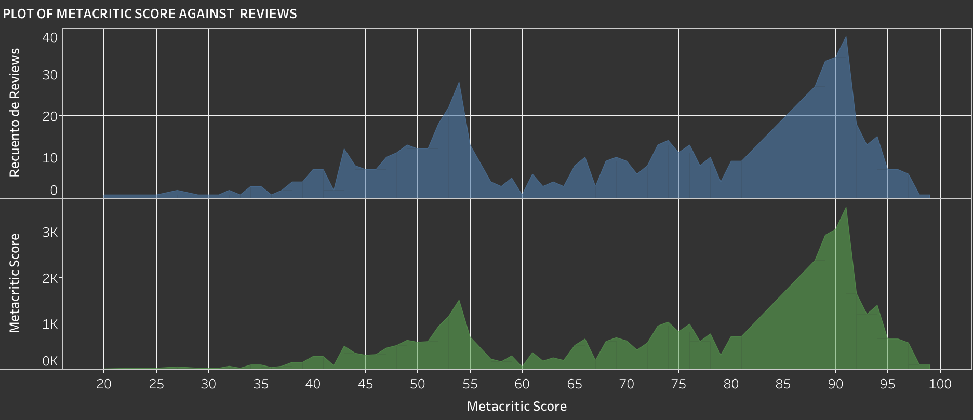

Slide 20
There is still a lot to be done.
Namely:
- Extracting features from reviews to determine what users like or dislike in games
- Analysis of the Steam Dataset

Slide 21

THANK YOU FOR LISTENING!

